Slide 1
Quasi-Newton Methods (10.9)

Slide 2
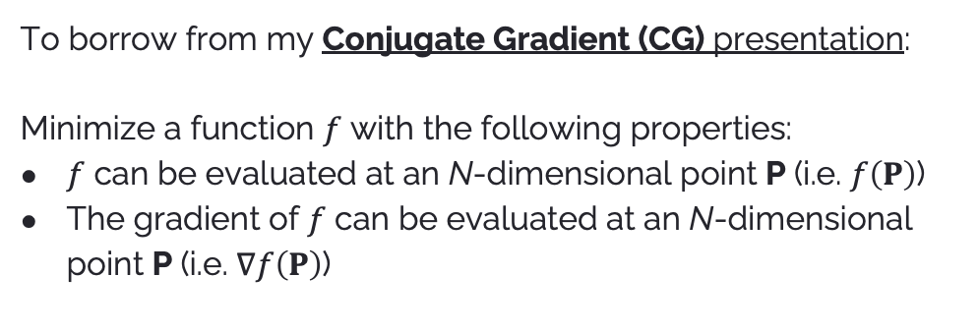
Objective
To borrow from my Conjugate Gradient (CG) presentation:
Minimize a function $f$ with the following properties:
$f$ can be evaluated at an N-dimensional point P (i.e. $f\left(P\right)$)
The gradient of $f$ can be evaluated at an N-dimensional point P (i.e. $∇f\left(P\right)$)

Slide 3
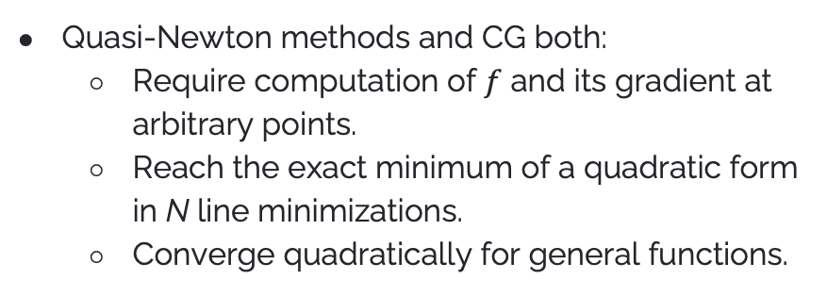
Similarities to CG
Quasi-Newton methods and CG both:
Require computation of $f$ and its gradient at arbitrary points.
Reach the exact minimum of a quadratic form in N line minimizations.
Converge quadratically for general functions.

Slide 4
CG vs. Quasi-Newton Methods
CG’s main advantage is that it requires intermediate storage on the order of N, while quasi-Newton methods require storage on the order of N x N. The book notes “for any moderate N, this hardly matters.”
However, quasi-Newton methods:
Typically converge faster than CG (we’ll get into this later).
Are more robust to ill-conditioned problems, special conditions, and numerical errors/approximations (good general-purpose).
Don’t need to restart every N iterations.

Slide 5
But how does it do it?
In other words, what makes quasi-Newton methods tick?

Slide 6
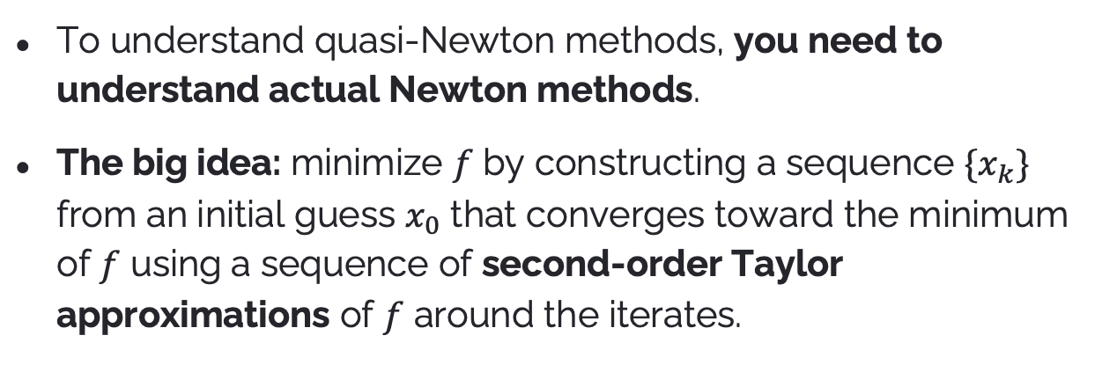
Newton’s Method in Optimization
To understand quasi-Newton methods, you need to understand actual Newton methods.
The big idea: minimize $f$ by constructing a sequence $\{x_{k}\}$ from an initial guess $x_{0}$ that converges toward the minimum of $f$ using a sequence of second-order Taylor approximations of $f$ around the iterates.
Source: Newton’s method in optimization @ Wikipedia

Slide 7
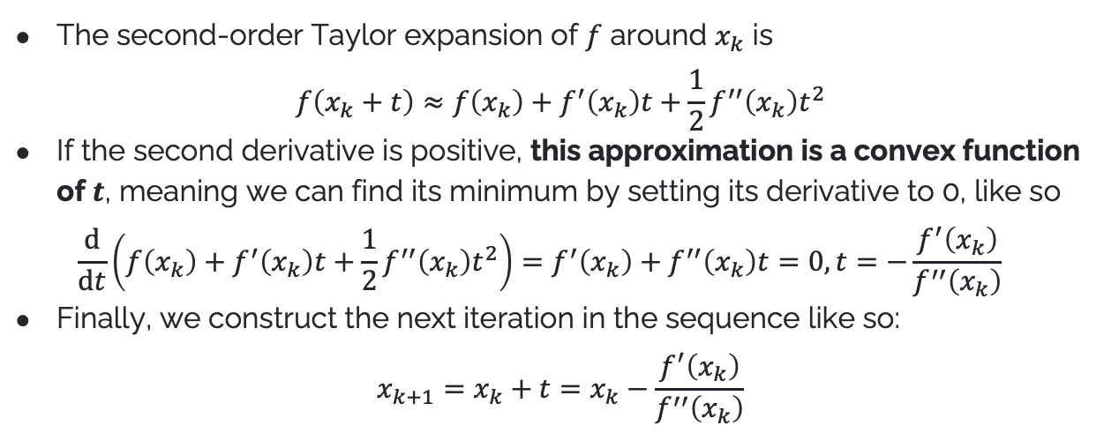
Newton’s Method in Optimization
The second-order Taylor expansion of $f$ around $x_{k}$ is $f\left(x_{k}+t\right)≈f\left(x_{k}\right)+f^{′}\left(x_{k}\right)t+\frac{1}{2}f^{′′}\left(x_{k}\right)t^{2}$
If the second derivative is positive, this approximation is a convex function of $t$, meaning we can find its minimum by setting its derivative to 0, like so $\frac{d}{dt}\left(f\left(x_{k}\right)+f^{′}\left(x_{k}\right)t+\frac{1}{2}f^{′′}\left(x_{k}\right)t^{2}\right)=f^{′}\left(x_{k}\right)+f^{′′}\left(x_{k}\right)t=0, t=−\frac{f^{′}\left(x_{k}\right)}{f^{′′}\left(x_{k}\right)}$
Finally, we construct the next iteration in the sequence like so: $x_{k+1}=x_{k}+t=x_{k}−\frac{f^{′}\left(x_{k}\right)}{f^{′′}\left(x_{k}\right)}$
Source: Newton’s method in optimization @ Wikipedia

Slide 8
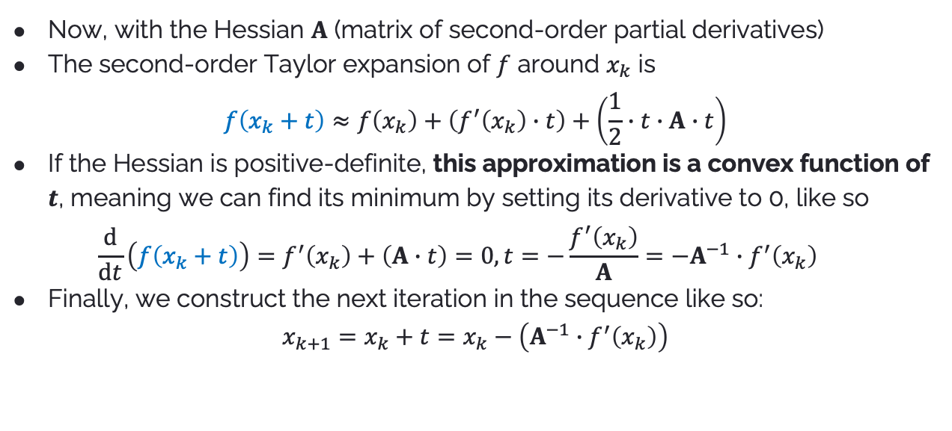
Newton’s Method in Optimization (with the Hessian)
Now, with the Hessian $A$ (matrix of second-order partial derivatives)
The second-order Taylor expansion of $f$ around $x_{k}$ is $f\left(x_{k}+t\right)≈f\left(x_{k}\right)+\left(f^{′}\left(x_{k}\right)∙t\right)+\left(\frac{1}{2}∙t∙A∙t\right)$
If the Hessian is positive-definite, this approximation is a convex function of $t$, meaning we can find its minimum by setting its derivative to 0, like so $\frac{d}{dt}\left(f\left(x_{k}+t\right)\right)=f^{′}\left(x_{k}\right)+\left(A∙t\right)=0, t=−\frac{f^{′}\left(x_{k}\right)}{A}=−A^{−1}∙f^{′}\left(x_{k}\right)$
Finally, we construct the next iteration in the sequence like so: $x_{k+1}=x_{k}+t=x_{k}−\left(A^{−1}∙f^{′}\left(x_{k}\right)\right)$
Adapted from 10.9 with modified notation.

Slide 9
The Problem
Note the following excerpts from Newton’s method: “If the second derivative is positive” / “if the Hessian is positive-definite”
This is not a given!
From 10.9: “In general, far from a minimum, we have no guarantee that the Hessian is positive-definite. Taking the actual Newton step with the real Hessian can move us to points where the function is increasing in value.”

Slide 10
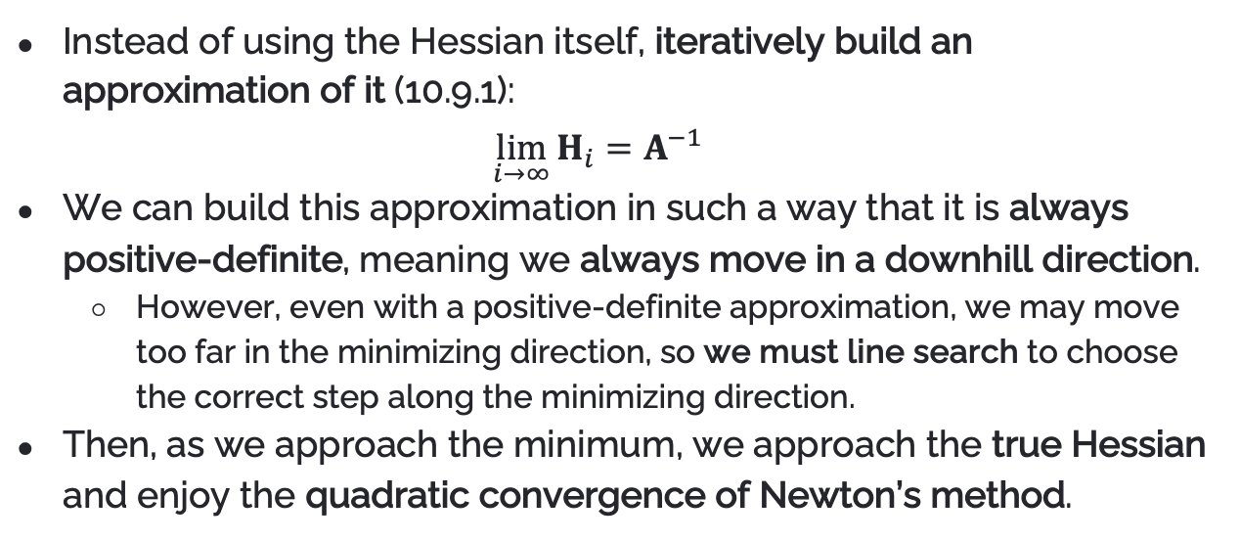
The Solution
Instead of using the Hessian itself, iteratively build an approximation of it (10.9.1): $\lim_{i→∞}{H_{i}}=A^{−1}$
We can build this approximation in such a way that it is always positive-definite, meaning we always move in a downhill direction.
However, even with a positive-definite approximation, we may move too far in the minimizing direction, so we must line search to choose the correct step along the minimizing direction.
Then, as we approach the minimum, we approach the true Hessian and enjoy the quadratic convergence of Newton’s method.

Slide 11
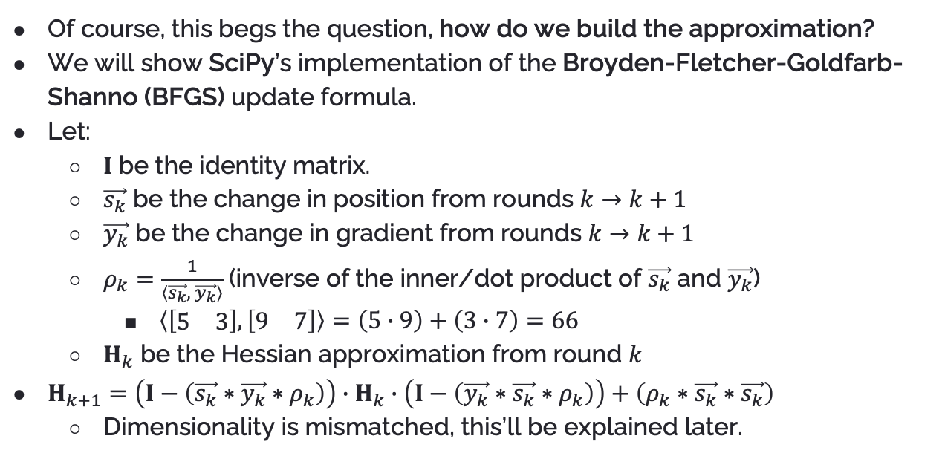
The Heart of the Solution
Of course, this begs the question, how do we build the approximation?
We will show SciPy’s implementation of the Broyden-Fletcher-Goldfarb-Shanno (BFGS) update formula.
Let:
$I$ be the identity matrix.
$\vec{s_{k}}$ be the change in position from rounds $k→k+1$
$\vec{y_{k}}$ be the change in gradient from rounds $k→k+1$
$ρ_{k}=\frac{1}{\left\langle \vec{s_{k}}, \vec{y_{k}}\right\rangle }$ (inverse of the inner/dot product of $\vec{s_{k}}$ and $\vec{y_{k}}$)
$\left\langle \left[\begin{matrix}5 & 3\end{matrix}\right],\left[\begin{matrix}9 & 7\end{matrix}\right]\right\rangle =\left(5∙9\right)+\left(3∙7\right)=66$
$H_{k}$ be the Hessian approximation from round $k$
$H_{k+1}=\left(I−\left(\vec{s_{k}}∗\vec{y_{k}}∗ρ_{k}\right)\right)∙H_{k}∙\left(I−\left(\vec{y_{k}}∗\vec{s_{k}}∗ρ_{k}\right)\right)+\left(ρ_{k}∗\vec{s_{k}}∗\vec{s_{k}}\right)$
Dimensionality is mismatched, this’ll be explained later.

Slide 12
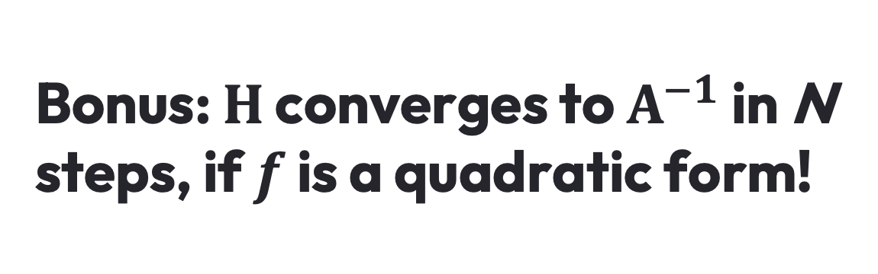
Bonus: $H$ converges to $A^{−1}$ in N steps, if $f$ is a quadratic form!

Slide 13
Next Up
BFGS is the default method used in SciPy’s minimize function when no constraints or bounds are provided.
SciPy is a highly performant, production-ready library for scientific computing.
To wrap up this presentation, we’ll walk through SciPy’s implementation of BFGS.

Slide 16
Initialize the value of the function and its gradient

Slide 17

Set $H_{0}$ to the identity matrix $I$

Slide 18
Initialize guess of step
along minimizing direction

Slide 20
2/5 termination conditions:
Norm of gradient less than tolerance (virtually 0 by default)
Iterations hit maximum

Slide 21
Calculate search direction ($p_{k}$) using the approximated Hessian

Slide 22
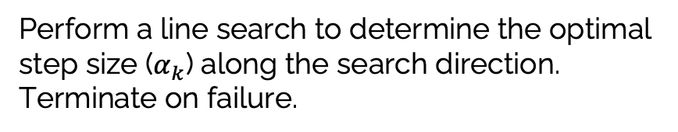
Perform a line search to determine the optimal step size ($α_{k}$) along the search direction.
Terminate on failure.

Slide 23

Calculate the change in position $s_{k}$ and get the current point by applying $s_{k}$ to the previous point.

Slide 24
Calculate the gradient at the current point

Slide 25

Calculate the change in gradient $y_{k}$, save the current gradient, and increment the iteration.

Slide 27
Repeat of one of the termination conditions in the function’s while loop.

Slide 28
Terminate if step size is below the tolerance.

Slide 29
Terminate if the function value is infinite

Slide 31
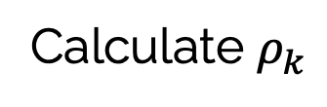
Calculate $ρ_{k}$

Slide 32
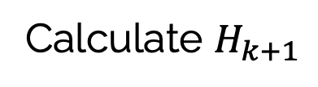
Calculate $H_{k+1}$

Slide 33
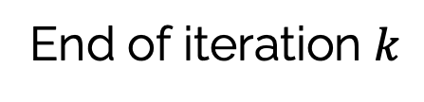
End of iteration $k$

Slide 34
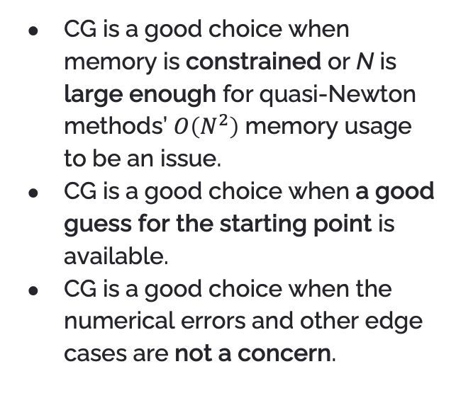
Choosing CG or Quasi-Newton Methods
CG is a good choice when memory is constrained or N is large enough for quasi-Newton methods’ $O\left(N^{2}\right)$ memory usage to be an issue.
CG is a good choice when a good guess for the starting point is available.
CG is a good choice when the numerical errors and other edge cases are not a concern.
Quasi-Newton methods are a good choice in compute-abundant scenarios.
Quasi-Newton methods are a good choice when the starting point may be far away from the minimum.
Quasi-Newton methods are a good choice when many iterations are acceptable.
Quasi-Newton methods are a good choice when the minimization technique must be robust.

Slide 35
Thanks!
Joshua Sheldon
jsheldon2022@my.fit.edu

